Slide 1
FY 2020 Community Grants Training
November 8, 2018

Slide 2
AGENDA
Welcome and Introductions
LDC Grant Eligibility and Strategic Priorities
Application Process
Grant Requirements- once funds have been awarded

Slide 3
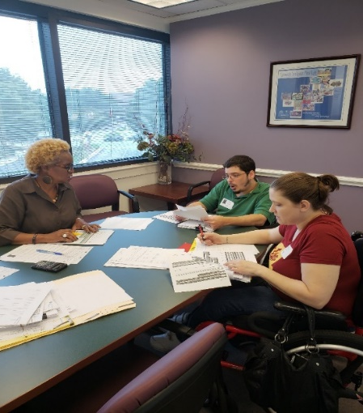
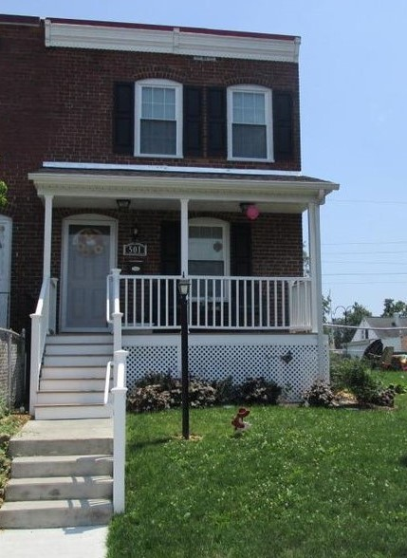
Arundel Community Development Services, Inc.
Nonprofit housing & community development agency established in 1996
Housing rehabilitation, affordable rental development, housing counseling, financial empowerment, accessibility modifications, public facilities, and energy & weatherization improvements
Experienced grant administrator & manager of capital projects

Slide 4
LDC Community Grants
Local Development Council (LDC) Community Grants are funded through casino revenues.
The amount available varies each year depending on revenues. This year the LDC has established a target of making $400,000 in Community Grant recommendations.

Slide 5
Eligible Grant Applicants
Community Association - file either a Form 990 or 1120 tax return; or
Nonprofit Organization - with 501 c 3 status
AND
Located in Anne Arundel County within 3 miles of the Maryland Live! Casino. Applications from organizations outside the three mile radius will be considered if they demonstrate significant impacts for residents of the target area.

Slide 7
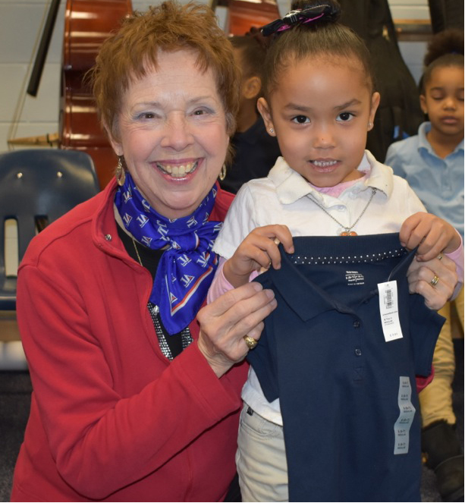
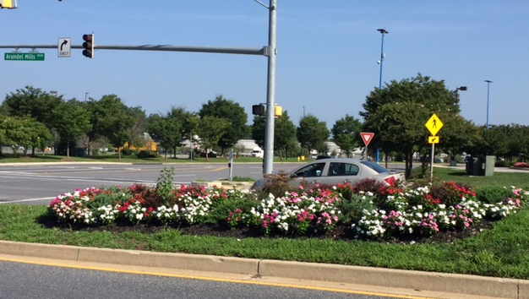
LDC Strategic Priorities
Creating Excellent Schools
Creating Sustainable Opportunities for Individuals & Families
Beautifying and Revitalizing Our Communities

Slide 8
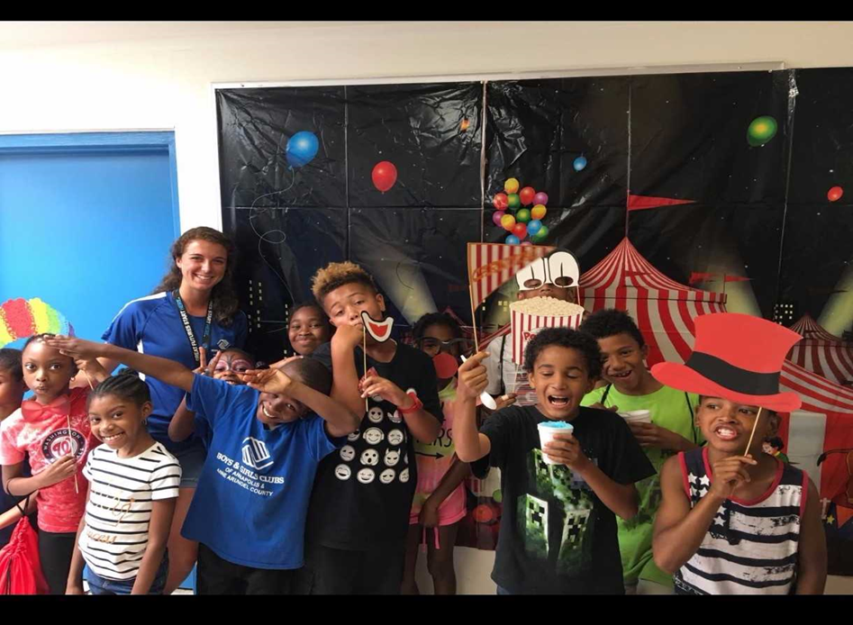
Eligible Activities
Capital Projects, including construction, landscaping, playground and signage installation, and housing rehabilitation.
Operating Programs, including staff costs, overhead and equipment purchases.

Slide 9
LDC Award Process
FY20 LDC Grant Applications are available now on our website
December 19, 2018
Community Grant Applications due to ACDS
February - May 2019
LDC Grant Committee reviews applications and invites Community Grant applicants to make presentations at the March, April and May LDC meetings
May 2019
LDC makes final Community Grant award Recommendations to County Executive
June 2019
FY 2020 Budget approved by County Council
Summer 2019
Grantees meet final grant award requirements and execute award agreements
Grantees should not expend funding until agreements are executed by both parties and they speak to their ACDS grant manager.

Slide 10
Application Process
Focus on the impact that LDC funding will have on your organization’s ability to serve residents in the 3 mile radius.
Required Documents:
Federal tax-exempt determination letter (501 c(3) or 1120/990 form)
W-9 (signed)
Good Standing - https://dat.maryland.gov/Pages/default.aspx
Bylaws
Mission Statement
Articles of Incorporation
Letter of Support
List of Board of Directors/Trustees – names, terms
Conflict of Interest Policy
Previous year financial statements – Audit report or federal tax returns

Slide 11
Budget Narrative
Operating and Program Support – Form A, C
Capital Projects – Form B, C
In-Kind Donations
How did you establish value for in-kind services/goods?
How to value volunteer time
https://independentsector.org/value-of-volunteer-time-2018/
If purchasing equipment with LDC funds, also complete Form D

Slide 12
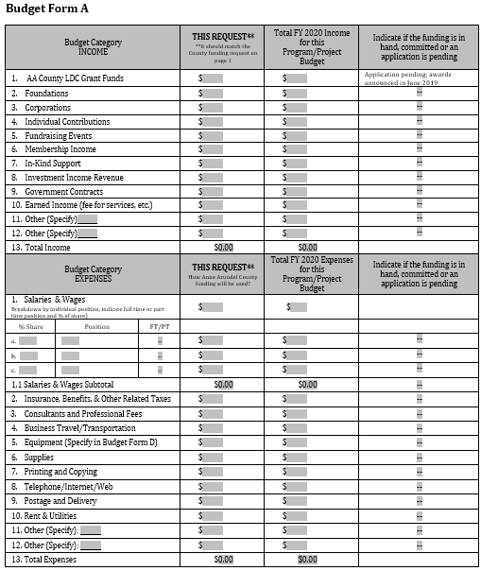

Slide 13
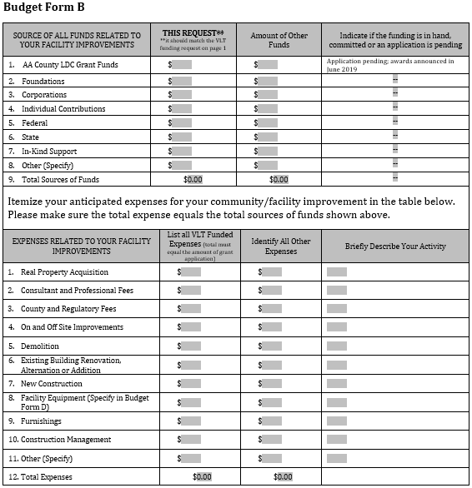

Slide 15
GRANT REQUIREMENTS

Slide 16
Insurance Requirements
Sample Insurance Certificate
Capital Project Additional Insured
Workers Comp Exemption letter

Slide 17
Authorized Signatory
ACDS must have on file explicit authorization for someone in your organization to be the signatory on all grant-related documents
Example Resolution

Slide 18
Invoicing
IMPORTANT: Do Not Start Spending money until you are under contract and you have talked to your grant rep about how to invoice
Operating Grants - reimbursement basis
Exceptions may be made after consulting your grant manager
Example
Capital Grants – invoices/receipts

Slide 19
Close-Out Reporting
Operating Grants
Final Report
Financial Review – Independent review of the organization finances as a whole
Monitoring – contact David Sims, dsims@acdsinc.org, to schedule a monitoring visit during program implementation
Pictures!
Capital Grants
Capital Grants – site inspection
Pictures!

Slide 20
QUESTIONS

